Slide 1
Philly Responds to an Anti-Islamic Ad Campaign: A Case Study

Slide 2
AFDI Ad on SEPTA

Slide 3
American Freedom Defense Initiative (AFDI)
Sponsors of the anti-Islamic ad campaign in cities across the United States and Canada. The AFDI is listed as a hate group by the Southern Poverty Center. ¹

Slide 4
Pamela Gellar, Executive Director, American Freedom Defense Initiative
“AFDI acts against the treason being committed by national, state and local government officials, the mainstream media, and others in their capitulation to the global jihad and Islamic supremacism, the ever-encroaching and unconstitutional power of the federal government, and the rapidly moving attempts to impose socialism and Marxism upon the American People” – Biography of Pamela Gellar on AFDI website²
Image from http://freedomdefense.typepad.com/fdi/2015/03/winning-in-philly-suing-in-nyc-and-running-in-dc.html#more

Slide 5
ADFI Ads in Other Cities: New York City

Slide 6
AFDI Ads in Other Cities: Washington, DC

Slide 7
AFDI Ads in Other Cities: San Francisco

Slide 8
AFDI Ads in Other Cities: Chicago

Slide 9
AFDI Ads in Other Cities: Westchester, NY

Slide 10
AFDI Ads in Other Cities: Edmonton (Canada)

Slide 11
TIME OUT: Take a closer look
Stop
Think
Feel
Ask
Respond

Slide 12
Transportation Authority Disclaimer: San Francisco

Slide 13
Transportation Authority Disclaimer: New York City

Slide 14
Counter Ad: New York City

Slide 15
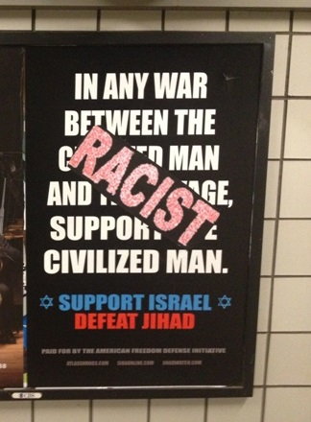
Unauthorized, Anonymous Activism: Countrywide

Slide 16
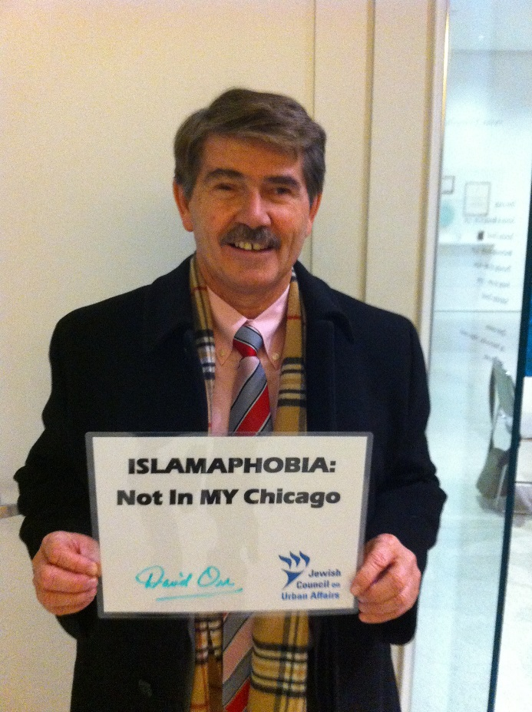
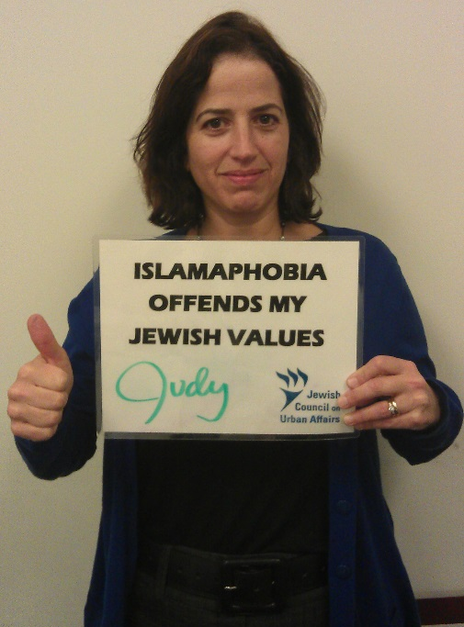
Social Media Campaign: Chicago
“Not In My Chicago”

Slide 17
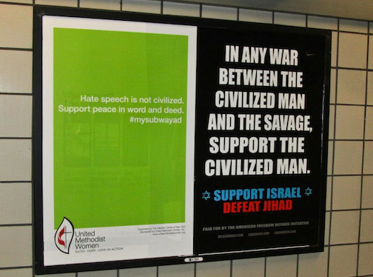
Counter Campaign: New York
#MySubwayAd

Slide 18
Hashtag Campaign: San Francisco
#MyJihad

Slide 19
Hashtag Campaign: Washington DC
#SpreadHummusNotHate

Slide 20
Response from the Interfaith Center of Greater Philadelphia
#DareToUnderstand

Slide 21
Ad from the Philadelphia Metro Paper back page. Ran on April 9th 2015 to combat the AFDI’s Anti-Islamic ads run on Septa

Slide 22
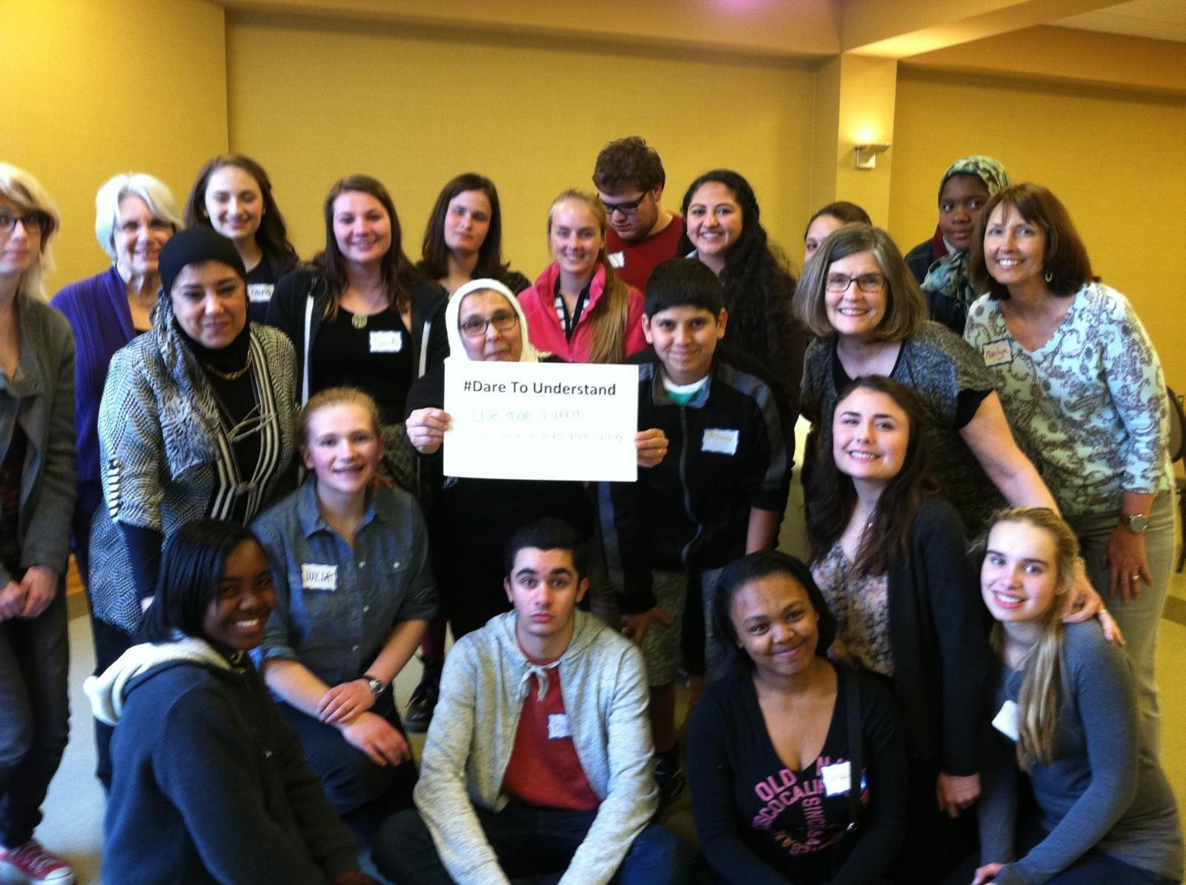
#DareToUnderstand

Slide 23
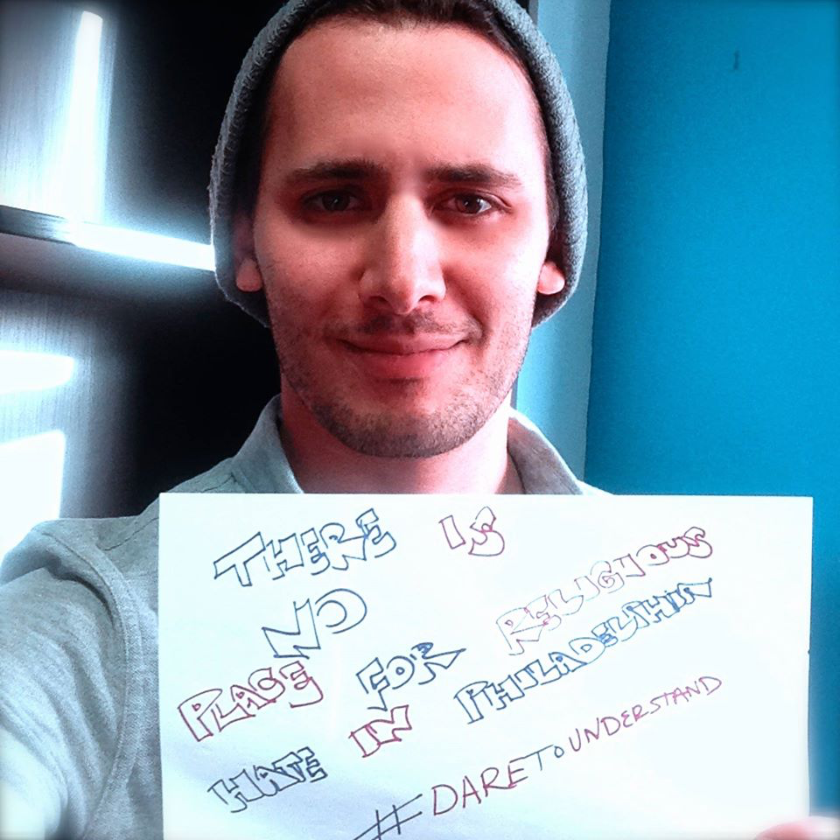
#DareToUnderstand

Slide 24
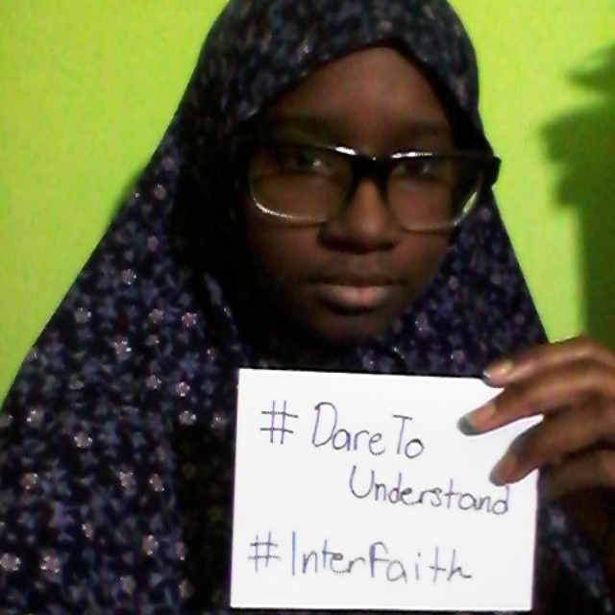
#DareToUnderstand

Slide 25
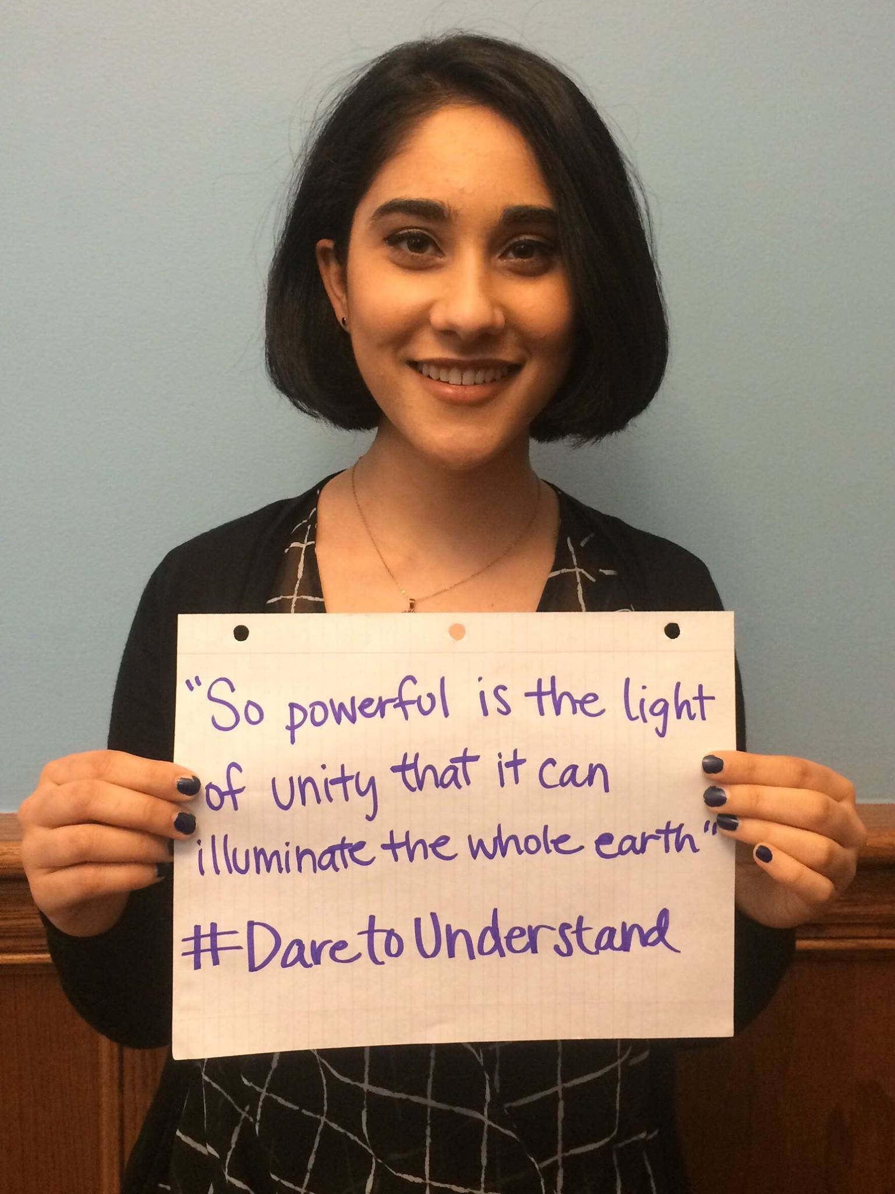
#DareToUnderstand

Slide 26
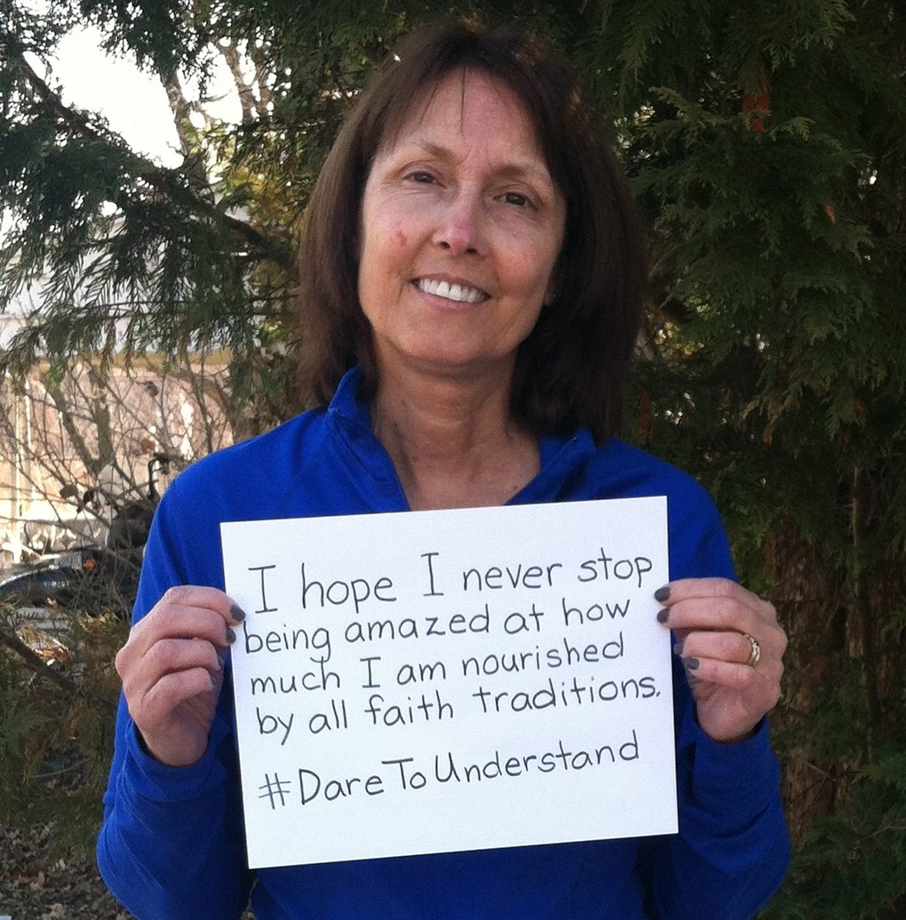
#DareToUnderstand

Slide 27
#DareToUnderstand

Slide 28
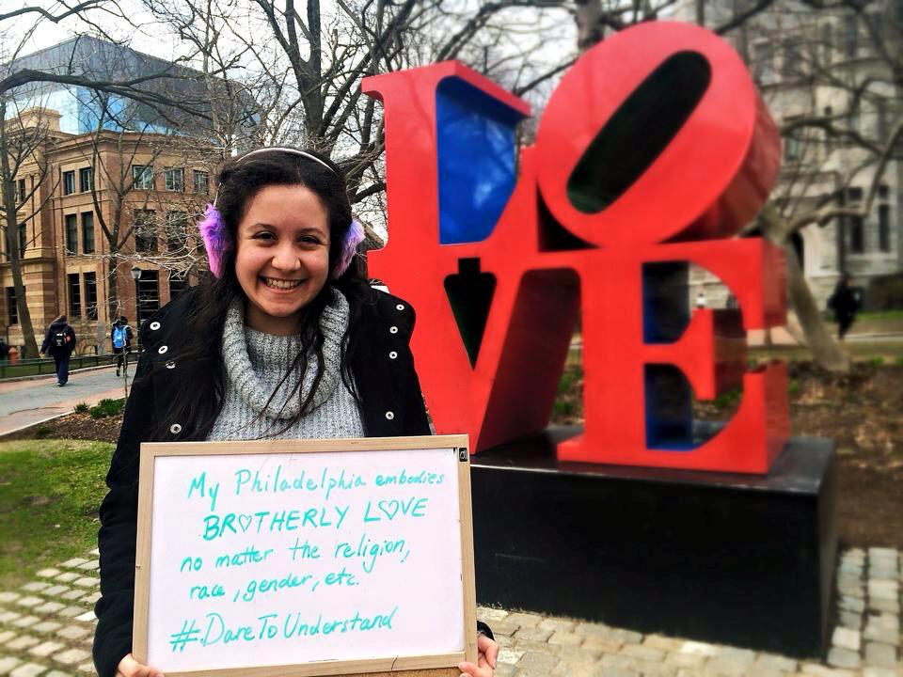
#DareToUnderstand

Slide 29
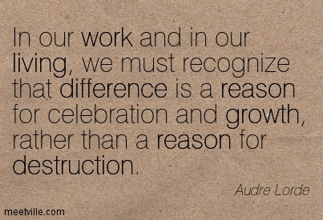

Slide 30
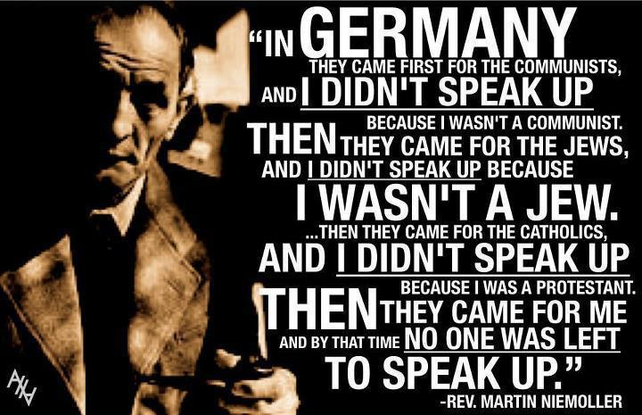

Slide 32
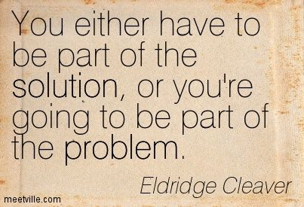

Slide 33
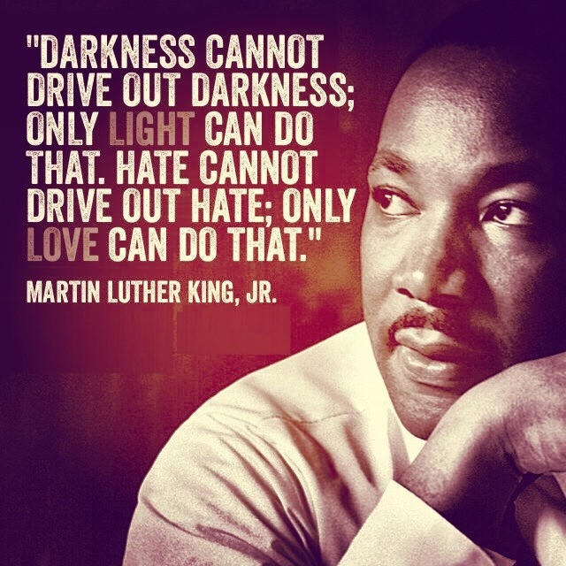

Slide 34
How will you respond?

Slide 36
References
¹Southern Poverty Law Center. “Hate Map.” Southern Poverty Law Center. Southern Poverty Law Center, n.d. Web. 15 Apr 2015
²Geller, Pamela. "Pamela Geller." Pamela Geller. American Freedom Defense Initiative, n.d. Web. 15 Apr. 2015.

